Slide 1
Building a Kubernetes-native control plane with Crossplane
Cloud Native Kuala Lumpur, Feb 2026 Meetup
Vasil Shaikh
Senior DevOps Engineer @NTT Data

Slide 2
About Me
Vasil Shaikh DevOps / Platform Engineer
Works on Kubernetes-based platforms and cloud infrastructure
Hands-on with Crossplane, Backstage, and AWS in real-world environments
Focused on platform engineering, self-service infrastructure, and reducing operational friction for teams
Enjoys turning complex infrastructure problems into simple, repeatable workflow
https://www.linkedin.com/in/vasilshaikh/

Slide 3
Agenda
The Problem
The Shift: Platform Engineering
What is Crossplane
Core Concepts
How It Works
Example: How does a claim look like?
Live Demo: Provisioning a Database
What’s Next: Crossplane v2
Q&A

Slide 4
The Problem
Scenario: “I just need a database”
Developer needs a PostgreSQL DB for a new service
Raises a ticket with infra requirements
Back-and-forth on size, networking, security
Click Ops or IaC provisioning by ops
Credentials shared separately
Drift & inconsistencies appear later
Result: ❌ Slow delivery ❌ Snowflake infrastructure ❌ Ops becomes the bottleneck

Slide 5
The Shift: Platform Engineering
Platform Engineering isn’t a new tool — it’s the discipline of building and maintaining Internal Developer Platforms (IDPs) that enable self-service infrastructure.
Self-service: Developers provision infrastructure without relying on Ops or Platform teams
Golden paths: Standardized, well-tested workflows that teams can trust
Abstraction: Developers consume infrastructure through simple APIs instead of learning cloud tools
Platform as a product: Built-in security, faster time-to-market, and a consistent developer experience — where platform teams build the product and developers are the users

Slide 6

The Developer Experience We Want
Now imagine if instead of raising a ticket, a developer could just say:
“I want a database, in this environment, with these guardrails.”
And the platform takes care of the rest.
This is where Crossplane enters the picture.

Slide 7

What is Crossplane?
Crossplane Is the Cloud-Native Framework for Platform Engineering.
Simply put it’s an open-source K8s add-on that transforms your cluster into a universal control plane to manage infrastructure across cloud providers as well as on-prem environments.
Universal control plane - Single API for managing multi-cloud resources
Declarative approach - Describe desired state, let crossplane handl implementation
Kubernetes-native - Leverages existing K8s skills & tooling

Slide 8
Core Concepts
Component | Abbreviation | Scope | Purpose
Provider | - | Cluster | A package (e.g., AWS, Azure, GCP) that installs CRDs and controllers to manage external resources.
ProviderConfig | PC | Cluster | Defines authentication and configuration (credentials, region) for a specific Provider.
Managed Resource | MR | Cluster | A granular Kubernetes object representing a single cloud resource (e.g., an RDS instance or S3 bucket).

Slide 9
Core Concepts (contd.)
Component | Abbreviation | Scope | Purpose
Composite Resource Definition | XRD | Cluster | The "API Blueprint" that defines the schema for custom, high-level infrastructure types.
Composition | - | Cluster | The "Template" that maps a high-level XR to specific Managed Resources (MRs).
Composite Resource | XR | Cluster | The cluster-scoped instance of a defined infrastructure bundle.

Slide 10
Core Concepts (contd.)
Component | Abbreviation | Scope | Purpose
Composite Resource Claim | XRC / Claim | Namespace | The developer-facing request used to provision infrastructure within a specific namespace.

Slide 11
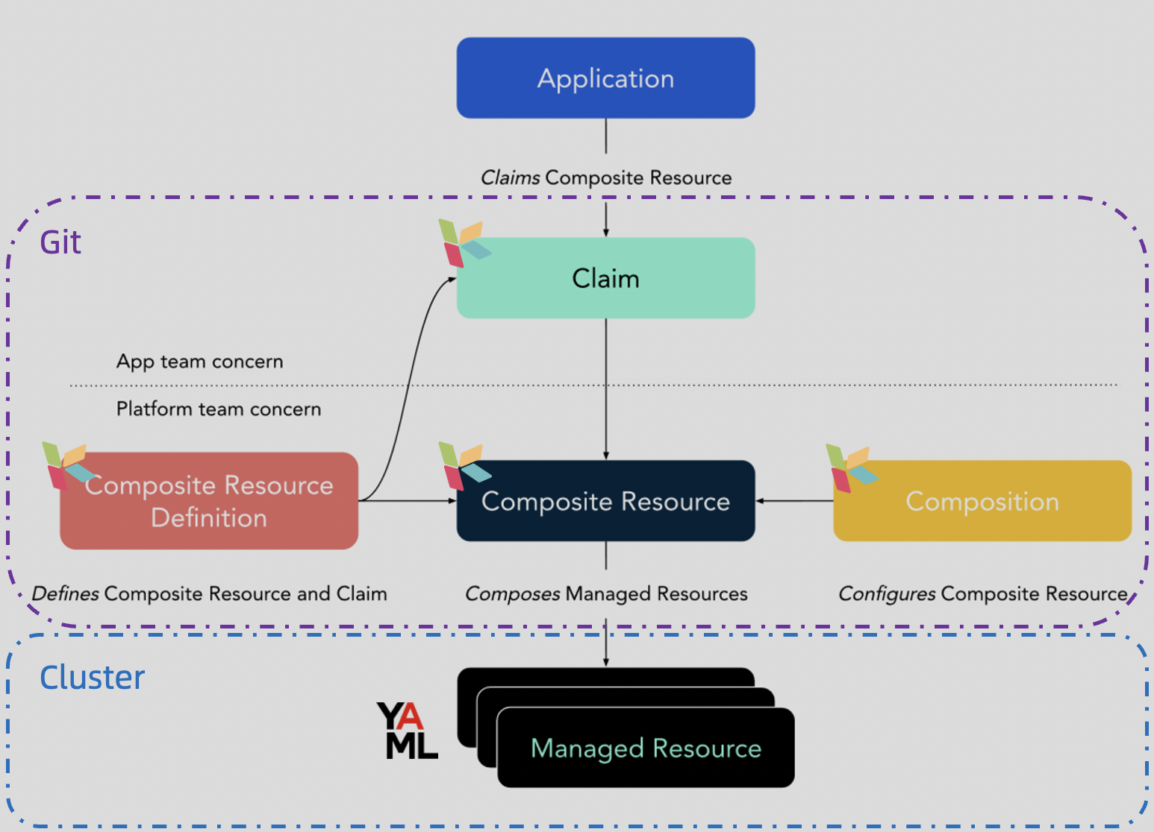

Slide 12
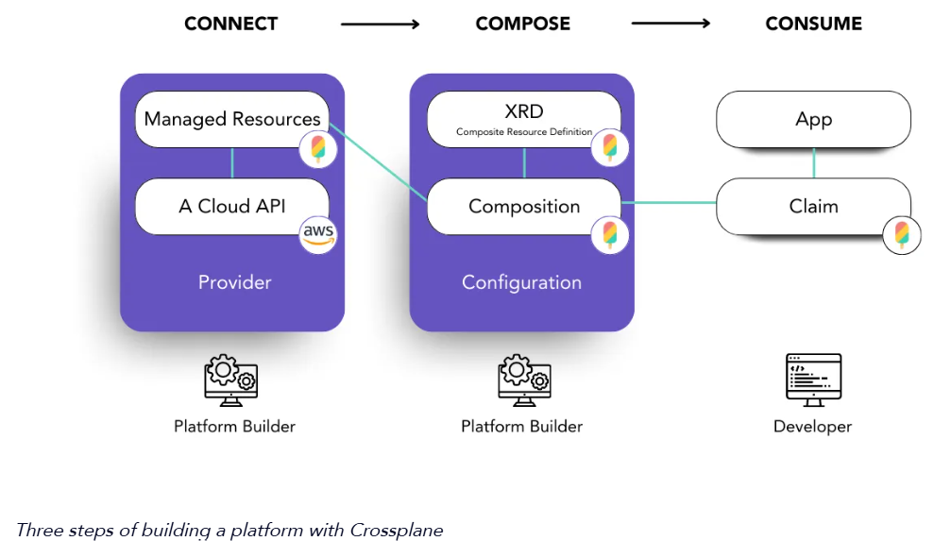
How it works

Slide 13
Example: How does a claim look like?
apiVersion: platform.iamvasil.com/v1alpha1
kind: DatabaseClaim
metadata:
name: dev-app-db
namespace: dev
spec:
environment: dev
size: small
databaseName: testapp
writeConnectionSecretsToNamespace: dev

Slide 14
Traditional Developer Request
“I need a PostgreSQL database”
Infrastructure Team Response:
What size and performance requirements?
Which region and availability zones?
What networking and security setup?
Backup and monitoring requirements?
Connection and credential management?
Timeline: ⏳ 2–3 weeks of back-and-forth conversations
Traditional Developer Request (But now with Crossplane)
“I need a PostgreSQL database”
Platform Response:
apiVersion: platform.company.com/v1alpha1
kind: Database
metadata:
name: my-app-db
spec:
size: medium
environment: production
Platform Action:
Automatically creates VPC, subnets, security groups
Provisions RDS with approved configurations
Sets up monitoring and backups
Delivers credentials securely
Timeline:
⚡ 5–10 minutes, fully automated

Slide 15

Live Demo: Let the action begin!
Scan the QR for repo link

Slide 16

Live Demo: What could possibly go wrong?

Slide 17
Live Demo (Recording)

Slide 18
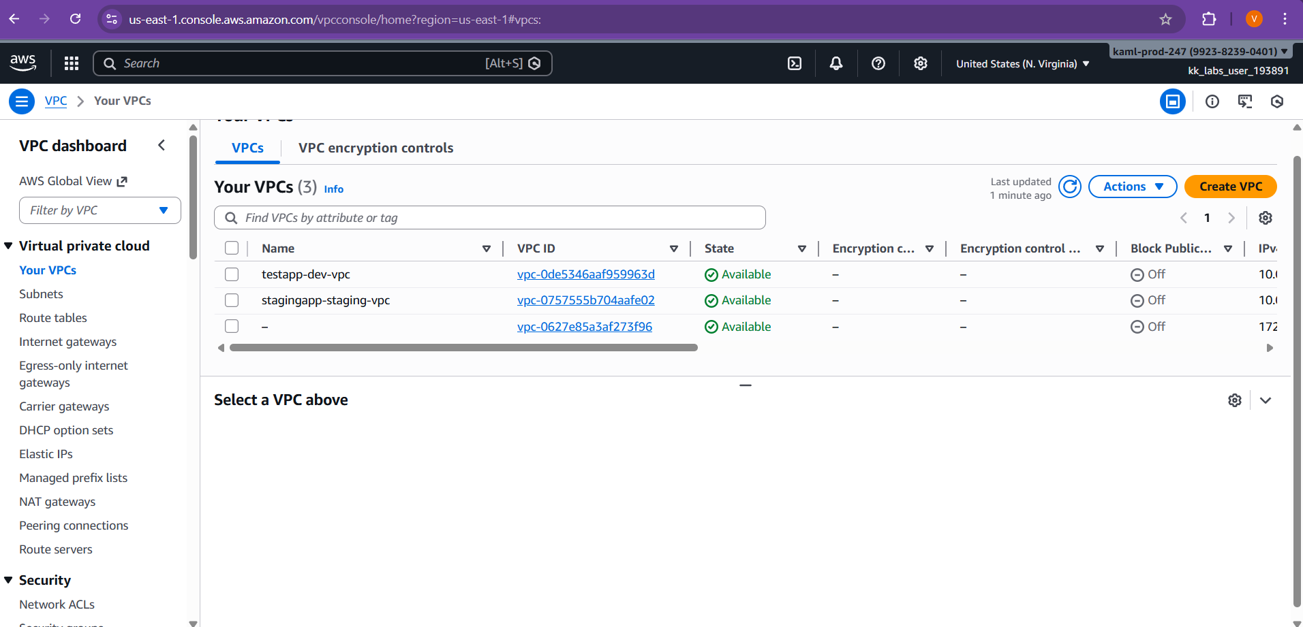

Slide 19
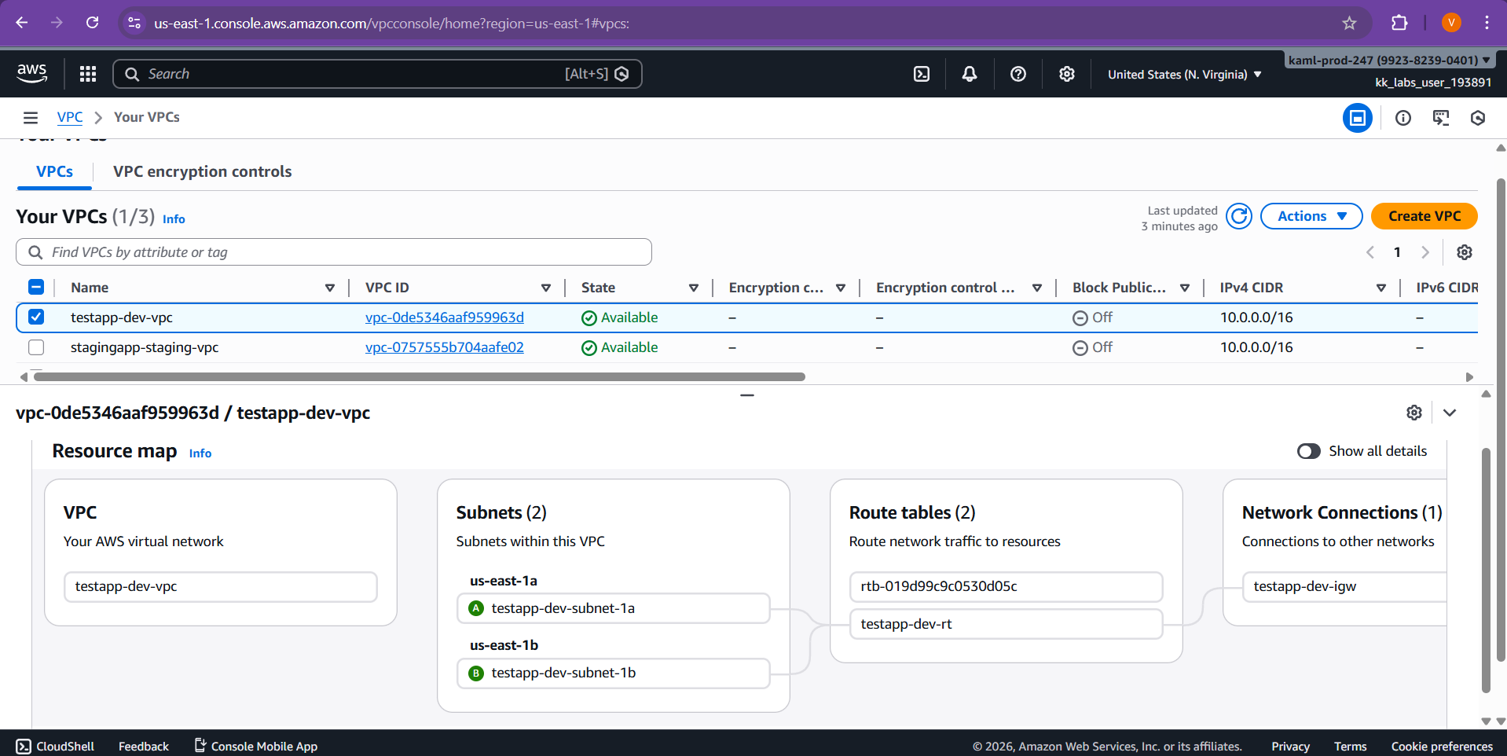

Slide 20
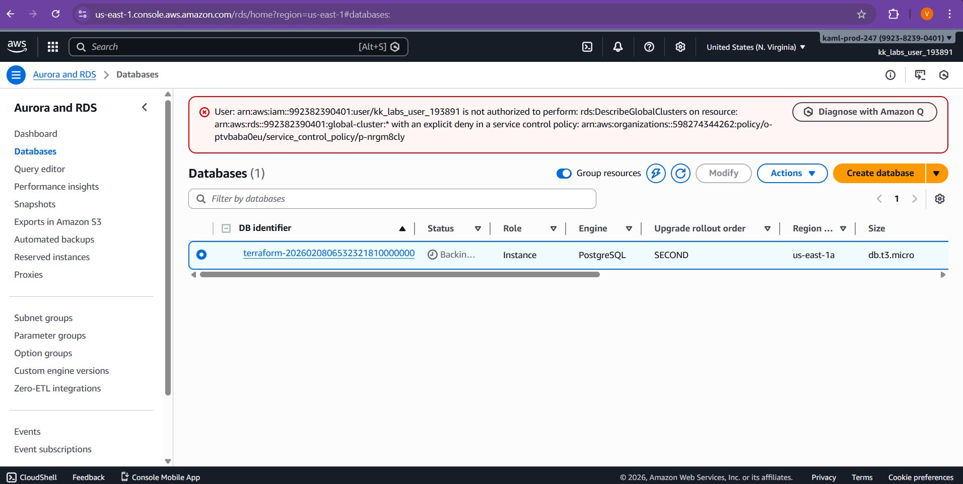

Slide 21
What’s next: Crossplane v2
What’s Changing in Crossplane v2?
Crossplane v2 simplifies how composite resources (XRs) and managed resources (MRs) are structured:
Namespaces by default – Most composite resources (XRs) and all managed resources (MRs) are now namespaced.
Broader composition capabilities – XRs can now compose any Kubernetes resource, not just MRs.
Claims are removed – This reduces complexity and aligns Crossplane more closely with Kubernetes conventions.
These changes make it easier to manage applications and infrastructure in a unified way, without the need for extra cluster-scoped components.

Slide 22
Questions?

Slide 23

Let’s connect!

Slide 24
Resources
https://www.crossplane.io/
https://docs.crossplane.io/v2.1/whats-crossplane/
https://blog.upbound.io/composing-a-platform-by-patching-crossplane-resources
https://www.kcl-lang.io/blog/2024-03-04-crossplane-marketplace-kcl
https://blog.crossplane.io/announcing-crossplane-v2-proposal/

